Slide 1
Introduction to Blockchain Technologies
Notes:
Python for Tool Developers
1

Slide 2
Course Program
Module 1 – Quick Overview
Module 2 – Usage
Module 3 – Introduction to the Blockchain
Module 4 – Mining and Transactions
Module 5 – Centralized and Decentralized Blockchains
Module 6 – Conclusions
2
Python for Tool Developers
Notes:
Python for Tool Developers
2

Slide 3
Module 1
Quick Overview
3
Notes:
Python for Tool Developers
3

Slide 4
BlockChain History
The Blockchain and its first use case, Bitcoin introduced in January 2009
Founder was Satoshi Nakamoto. However, Satoshi Nakamoto is a pseudonym.
No one knows who the true inventor of the Blockchain is.
The blockchain is built on the foundations of many other technologies.
4
Python for Tool Developers
Notes:
Blockchain History
The blockchain was first presented to the world in January, 2009 by a person or persons known only as Satoshi Nakamoto, which is a pseudonym.
The first information recorded on the Blockchain was the headline in the Times of London on January 3, 2009 entitled:
“Chancellor Alastair Darling on brink of second bailout for banks.”
The blockchain was built on the foundations of many different technologies, including:
Hashcash by Adam Back
Merkle Trees by Ralph Merkle
Secure Cryptographic Hashing
Bloom Filters
And many others.
This would give us a new list where each number is a square of the original. However, Python gives us a much easier way to write this:
This new construct is a List Comprehension. This is a fast, and powerful way to create new lists. Additionally, it produces faster python code than the original code above.
Python for Tool Developers
4
originalList=[2,4,,8,10,12,14,16,18,20]
newList = []
for number in originalList:
newlist.append(number * number)
originalList = [2,4,6,8,10,12,14,16,18,20]
newList = [number * number for number in OriginalList]

Slide 5
Blockchain Decentralization
The blockchain is designed as a decentralized peer to peer (P2P) application.
The first real world use case was Bitcoin.
The Bitcoin blockchain is permissionless. No individual, group, organization, corporation or government controls the information on the Blockchain.
The only people allowed to write into the Blockchain are the miners.
The blockchain is read-only for all others.
5
Python for Tool Developers
Notes:
Blockchain Decentralization
The original Bitcoin blockchain was designed as a decentralized, peer to peer application where no one organization has control over it.
There is no requirement to join, nor any requirement to participate in the network.
The only people allowed to write into the blockchain are the ‘miners’, who are required to solve a particular difficult math problem in order to obtain the rights to store a new block onto the blockchain.
The blockchain is read only for all others. In addition to the miners, there are also validation nodes which validate the transactions on the network as well as client application which allow users to participate in the network.
Python for Tool Developers
5
Celsius = (37.4,23.2,11.5,2.7)
Fahrenheit= [ ((float(9) / 5) * temp + 32) for temp in Celsius]
noprimes = [j for i in range(2,8) for j in range(i*2,100,i)]
primes = [x for x in range(2,100) if x not in noprimes]

Slide 6
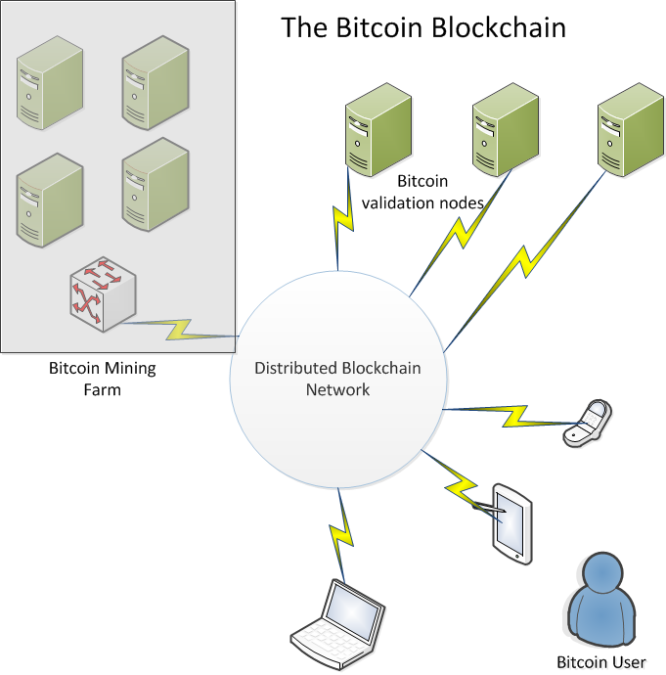
Blockchain Decentralization
6
Python for Tool Developers
Notes:
Python for Tool Developers
6
Celsius = (37.4,23.2,11.5,2.7)
Fahrenheit= [ ((float(9) / 5) * temp + 32) for temp in Celsius]
noprimes = [j for i in range(2,8) for j in range(i*2,100,i)]
primes = [x for x in range(2,100) if x not in noprimes]

Slide 7
Blockchain Permissioning.
The original blockchain for Bitcoin was designed as a permissionless system.
No requirements were needed to join.
Data is transparent. All transactions on the Bitcoin blockchain are visible to everyone on the network.
Lately, other types of Blockchains have emerged. Notably Hyperledger which is sponsored by IBM and other large corporations.
7
Python for Tool Developers
Notes:
Blockchain Decentralization
The original Bitcoin blockchain was designed as a decentralized, peer to peer application where no one organization has control over it.
There is no requirement to join, nor any requirement to participate in the network.
The blockchain was designed as a transparent distributed database. All transactions going back to the initial ‘genesis’ transaction by Satoshi Nakamoto are visible on the Blockchain.
Some organizations view this as a drawback, so the concept of a ‘permissioned’ Blockchain which allows for more validation of users and tighter control over the system have emerged, for example, the Hyperledger project which is backed by a number of Fortune 500 companies including IBM.
Python for Tool Developers
7
Celsius = (37.4,23.2,11.5,2.7)
Fahrenheit= [ ((float(9) / 5) * temp + 32) for temp in Celsius]
noprimes = [j for i in range(2,8) for j in range(i*2,100,i)]
primes = [x for x in range(2,100) if x not in noprimes]

Slide 8
Theoretical Background
A blockchain transactions works as follows
A transaction is requested
This request is send over the P2P network to the ‘nodes’ or computers on the network
The nodes create a ‘block’ on the blockchain which includes your transaction.
Other nodes on the network validate the transaction within the block.
8
Python for Tool Developers
Notes:
When someone wishes to transact on the blockchain the following sequence of events occurrs.
The user requests a transaction through some interfacing software (usually known as a Blockchain wallet).
The wallet software broadcasts the transaction to the network, which stores it in a ‘pool’ of pending transactions
A miner successfully creates a block on the blockchain and includes the users transaction in the block.
The validation nodes verify the ‘correctness’ of the transaction and broadcast this out over a P2P system so that all
nodes on that network now have a record of that transaction in the blockchain ‘ledger’.
This is the concept of ‘distributed consensus’.
Python for Tool Developers
8
def f(x,n):
return(x+n)
g = lambda x,n: x+n
print (f(1,2))
print (g(1,2))

Slide 9
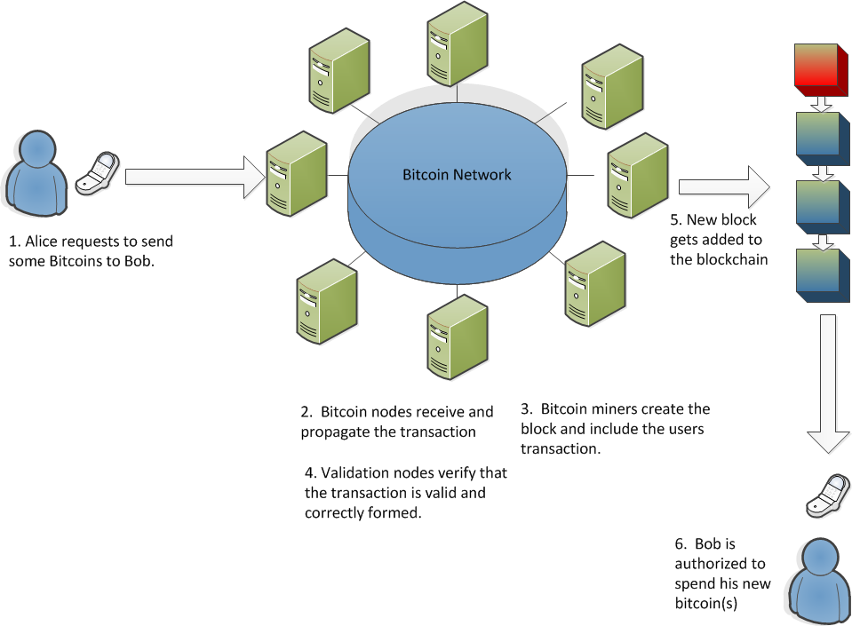
Theoretical Background
9
Python for Tool Developers
Notes:
Python for Tool Developers
9
def f(x,n):
return(x+n)
g = lambda x,n: x+n
print (f(1,2))
print (g(1,2))

Slide 10
Blockchain use cases
The first and most visible use case for the blockchain is for cryptocurrencies.
The ability to create and store digital tokens of value is hugely disruptive to the financial community.
The blockchain offers many exciting opportunities to innovate and create value propositions for consumers.
10
Python for Tool Developers
Notes:
Blockchain Use Cases
Bitcoin was the first use case for Cryptocurrencies and is still by far the most visible. The ability to create and store digital tokens that retain value and cannot be arbitrarily duplicated is a huge milestone for the financial technology community.
Many new companies have sprung up to take advantage of this new technology to form real value propositions for consumers and investors.
Examples of companies include:
Coinbase. A Bitcoin exchange based in San Francisco
Unocoin. An Indian based cryptocurrency exchange based in Mumbai.
BitPesa. A bitcoin remittance service based in Kenya that allows currency remittances in local currencies in Africa.
Python for Tool Developers
10
def f(x,n):
return(x+n)
g = lambda x,n: x+n
print (f(1,2))
print (g(1,2))

Slide 11
Blockchain use cases
Other use cases include strengthened Know Your Customer/Anti-Money Laundering (KYC/AML) systems.
Trading Platforms. Many exchanges, including NASDAQ are rolling out trading exchanges based on blockchain technology.
Payments. The remittance and payments sector is being actively disrupted by companies offering the blockchain as a method for conducing cross-nation, global payments.
11
Python for Tool Developers
Notes:
Blockchain Use Cases
KYC/AML compliance is becoming increasingly important in today’s global financial community. The need to fight both terrorism and organized criminal groups requires that financial institutions implement strict KYC/AML regulations. However, this implementation can come at a high cost. A Thomson/Reuters study showed that financial institutions were spending at least 60 million USD per year on regulation, with some organizations paying as much as 500 million USD per year on compliance.
There are proposals to store institutional KYC statements on a distributed blockchain ledger. Once the client has been verified, the information can placed securely on the blockchain and available by other financial institutions and accredited organizations, such as insurance companies or loan providers without the need for duplication of KYC effort. The blockchain guarantees the provisioning of the data so that other institutions no longer need to repeat the costly KYC checks.
Trading Platforms.
A key use for blockchain technologh is in the area of securities exchanges. With a blockchain, the need for a centralized trust system or an intermediary is obviated. Additionally, there is no risk of a double spend in the supply chain.
Additionally, the risks of fraud and errors would be significantly reduced since the blockchain makes the entire process transparent, secure and immutable. A clear audit trail of all trades becomes available to all parties, which provides legal and financial assurances of transaction authenticity.
A digital token would act as a certificate of authenticity so it makes forging of securities nearly impossible as opposed to dealing with paper documents. This would give securities a level of verifiable trust that is currently unavailable.
NASDAQ and the Australian Securities Exchange are busily developing blockchain-based exchanges to implement the noted features.
Payments
The blockchain can be used as a new way for both existing institutions and startup financial technology companies to facilitate payments between principals that does not depend on SWIFT or other existing payment scheme.
Using the blockchain to facilitate payments can reduce the amount of time spend between the first principal sending the payment and the second principal receiving the payment from days or weeks to minutes and hours. Additionally, the security of cross-border payments would be substantially increased.
One example of this is Ripple, a blockchain-based payment system designed for banks. Ripple is an open source blockchain that allows banks to make payments in a real time to counterparties without the need for intermediaries. The blockchain allows for real-time execution, transparency, fraud protection performed in real-time and at a much lower cost than with traditional methods
Python for Tool Developers
11
def f(x,n):
return(x+n)
g = lambda x,n: x+n
print (f(1,2))
print (g(1,2))

Slide 12
Blockchain use cases
Management of intellectual property. The Blockchain is being used to identify ownership rights for intellectual property such as music and other artistic works.
Insurance. The blockchain can solve many current problems that exist in the insurance industry.
Smart contracts (Ethereum). A relatively new innovation is the ability for the blockchain to run software as well as store data securely. The Ethereum blockchain is an example of this.
12
Python for Tool Developers
Notes:
Blockchain Use Cases
Management of intellectual property.
Digital rights expression is one of the biggest problems the music industry is tackling presently. It’s extremely difficult to clearly define which performers, songwriters, producers, publishers, and labels own the rights to songs and recordings and how royalties should be split between them.
This is an area where the blockchain can effect major changes. The blockchain ledger stores a cryptographic hash representing the digital content of every new song registered on the blockchain, along with lyrics, musical composition, liner notes, cover art, licensing, and other relevant information.
Since they are immutable distributed ledgers and are not owned by any single entity, blockchains will allow content creators to register ownership of their creations without the need for big record labels or other intermediaries.
The blockchain can also solve the problem of how content creators are paid for their work.
Currently, a string of publishers, record labels, talent agencies, streaming services, etc., each take a cut of revenue before passing any remaining amounts along to artists — after a 6- to 18-month delay.
The blockchain should allow royalties to flow directly through to the creators without the need for these intermediaries via the use of Smart Contracts, which are software applications executed directly on the blockchain.
Insurance.
The blockchain will allow insurance to make radical gains in efficiency in many areas of the business. For example :
Claims Registration.
to provide trusted and verified submission of claims data and documentation.
Enable automated pre-assessment of loss coverage against the insurancce policy.
Automate the process to engage repair and assistance proviceres to reduce response time and ensure use of preferred and trusted suppliers.
Claims assessment
To allow access to validated external data through trusted sources.
Enable automated determination of loss liability
Enable automated assessment of loss coverage for reinsurance.
Enable programmable escalation to human decision making in the case of complex risks.
Payment and closure,
To provide automatic payment to insurees through smart contracts.
To provide immutable and transparent proof of claim settlement.
Smart contracts
The ethereum blockchain pioneered the concept of a Smart Contract. Whereas blockchains such as bitcoins only allowed data storage on the blockchain, Ethereum allows users to write software and store and execute it directly on their blockchain. This innovation will allow users to write contracts and, indeed, entire applications using the Blockchain without the need for human intermediaries.
Smart contracts will allow a whole hosts of activities to be digitized, including financial derivatives, insurance contracts, and many other types of instruments.
Python for Tool Developers
12
def f(x,n):
return(x+n)
g = lambda x,n: x+n
print (f(1,2))
print (g(1,2))

Slide 13
Blockchain use cases
Application development. Many companies are in the process of developing applications on the Ethereum network and others to automate business preocesses.
Additionally, there is a lot of activity around the concept of Dapps or DAO’s, which are Distributed Autonomous Organizations which exist only on the blockchain.
IBM has its own blockchain that they are working on called Hyperledger in conjunction with the Linux foundation and other large organizations.
13
Python for Tool Developers
Notes:
Blockchain Use Cases
Management of intellectual property.
Digital rights expression is one of the biggest problems the music industry is tackling presently. It’s extremely difficult to clearly define which performers, songwriters, producers, publishers, and labels own the rights to songs and recordings and how royalties should be split between them.
This is an area where the blockchain can effect major changes. The blockchain ledger stores a cryptographic hash representing the digital content of every new song registered on the blockchain, along with lyrics, musical composition, liner notes, cover art, licensing, and other relevant information.
Since they are immutable distributed ledgers and are not owned by any single entity, blockchains will allow content creators to register ownership of their creations without the need for big record labels or other intermediaries.
The blockchain can also solve the problem of how content creators are paid for their work.
Currently, a string of publishers, record labels, talent agencies, streaming services, etc., each take a cut of revenue before passing any remaining amounts along to artists — after a 6- to 18-month delay.
The blockchain should allow royalties to flow directly through to the creators without the need for these intermediaries via the use of Smart Contracts, which are software applications executed directly on the blockchain.
Insurance.
The blockchain will allow insurance to make radical gains in efficiency in many areas of the business. For example :
Claims Registration.
to provide trusted and verified submission of claims data and documentation.
Enable automated pre-assessment of loss coverage against the insurancce policy.
Automate the process to engage repair and assistance proviceres to reduce response time and ensure use of preferred and trusted suppliers.
Claims assessment
To allow access to validated external data through trusted sources.
Enable automated determination of loss liability
Enable automated assessment of loss coverage for reinsurance.
Enable programmable escalation to human decision making in the case of complex risks.
Payment and closure,
To provide automatic payment to insurees through smart contracts.
To provide immutable and transparent proof of claim settlement.
Smart contracts
The ethereum blockchain pioneered the concept of a Smart Contract. Whereas blockchains such as bitcoins only allowed data storage on the blockchain, Ethereum allows users to write software and store and execute it directly on their blockchain. This innovation will allow users to write contracts and, indeed, entire applications using the Blockchain without the need for human intermediaries.
Smart contracts will allow a whole hosts of activities to be digitized, including financial derivatives, insurance contracts, and many other types of instruments.
Python for Tool Developers
13
def f(x,n):
return(x+n)
g = lambda x,n: x+n
print (f(1,2))
print (g(1,2))

Slide 14
Module 2
Introduction to the Blockchain
14
Notes:
Python for Tool Developers
14

Slide 15
Introduction to the blockchain
The primary purpose of the blockchain is to facilitate secure storage and retrieval of data.
The blockchain does this by constructing a series of blocks, which are really just data structures containing a list of transactions.
These blocks have a link to the previous block, hence providiing a chain of blocks that extend back to the first block created on the blockchain.
15
Python for Tool Developers
Notes:
The blockchain is effectively a list of blocks that contain multiple transactions collected together. The blocks are linked to each other in a backward fashion, that is to say, the last block in the chain points to the previous block, which points back to the one before that, and so on, back to the initial block in the blockchain, known as the genesis block.
Most blocks today are created using a concept called proof of work With proof of work, a person or a group called miners solve a difficult problem created by the blockc hain system. Once this problem is solved, the miner is allowed to submit a block of transactions to the network for validation. In the first transaction of the block, a reward token is granted to the miner. This is how new digital tokens are created on the network and how transactions are submitted to the network.
Python for Tool Developers
15
def f(x,n):
return(x+n)
g = lambda x,n: x+n
print (f(1,2))
print (g(1,2))

Slide 16
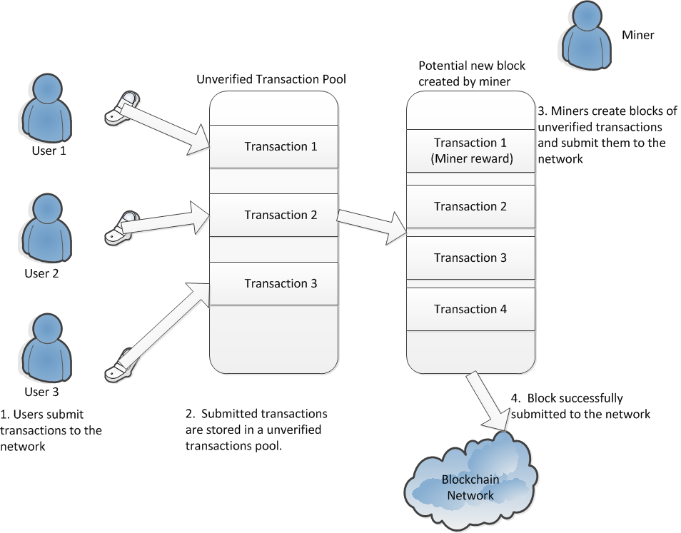
Introduction to the blockchain
16
Python for Tool Developers
Notes:
Python for Tool Developers
16
def f(x,n):
return(x+n)
g = lambda x,n: x+n
print (f(1,2))
print (g(1,2))

Slide 17
Introduction to the blockchain
The bitcoin proof of work algorithm is known in computer science as an NP problem. (NP stands for non polynomial)
Problems of this type grow exponentially more difficult as the complexity of the problem increases.
NP problems have no algorithmic shortcuts for efficiency.
An example of an NP problem is a crossword puzzle, which increases in difficulty exponentially as the size of the words in the puzzle increases.
17
Python for Tool Developers
Notes:
Python for Tool Developers
17
def f(x,n):
return(x+n)
g = lambda x,n: x+n
print (f(1,2))
print (g(1,2))

Slide 18
Introduction to the blockchain
Bitcoin proof of work algorithm leads to some level of centralization in the form of miners, which now require specialized hardware and massive amounts of capital to successfully mine blocks.
This is contrary to the spirit of a decentralized consensus system envisioned by Satoshi Nakamoto
The ethereum proof of work does not require specialized hardware to solve, so it is a more democratic solution
18
Python for Tool Developers
Notes:
Python for Tool Developers
18
def f(x,n):
return(x+n)
g = lambda x,n: x+n
print (f(1,2))
print (g(1,2))

Slide 19
Introduction to the blockchain
There exists two general types of blockchains, permissioned and unpermissioned.
The only real difference between the two is that permissioned blockchains restrict who can participate in the distributed consensus mechanism.
Permissioned blockchains allow the network to appoint a group of authorized participants who are allowed to validate the blocks.
Additionally, smart contracts can be restricted by the participants.
19
Python for Tool Developers
Notes:
The “DNA” of a permissioned blockchain network is no different than the “DNA” of an unpermissioned blockchain network. With the exception of one gene that has been mutated.
Properly permissioned blockchain networks differ from unpermissioned blockchain networks solely based on the presence (or absence) of an access control layer built into the blockchain nodes.
The first primary difference between a properly conceived permissioned blockchain network and an unpermissioned blockchain network is whether the participants in the network have an ability to restrict who can participate in the consensus mechanism of the blockchain’s network.
Permissioned blockchain networks allow the network to appoint a group of participants in the network who are given the express authority to provide the validation of blocks of transactions. Or, to participate in the consensus mechanism.
The second primary difference between a properly conceived permissioned blockchain network and an unpermissioned blockchain network is whether the participants in the network have an ability to restrict who can create smart contracts (if the blockchain node is logic optimized) and/or transact on the blockchain network.
Python for Tool Developers
19
def f(x,n):
return(x+n)
g = lambda x,n: x+n
print (f(1,2))
print (g(1,2))

Slide 20
Introduction to the blockchain
Permissioned blockchains usually perform better than permissionless blockchains.
Permissioned blockchains limit the type of transactions that can be created and validated.
Permissioned blockchains allow the network to appoint a group of authorized participants who are allowed to validate the blocks.
Additionally, smart contracts can be restricted by the participants.
20
Python for Tool Developers
Notes:
Blockchain networks in general are not very performant. But one can get better performance from a single blockchain network by limiting what that network is actually trying to manage. In any blockchain network, all the full nodes on the network perform all of the computation redundantly rather than in a segregated (traditional parallel computing) fashion.
So, when one is running a full node on a public blockchain network one is performing all of the computation for all of the applications running on the entire network. Should that single blockchain network explode in popularity, this will be a ton of computing power you would devote to managing the computational effort for applications other than the one you are trying to use.
This doesn’t make sense for every application. Particularly those applications which are enterprise in nature and need to have increased performance.
Permissioned blockchain networks do not abrogate the requirement that every full node on the network perform all of the computation for all of the network. Effectively these networks are breaking the computation requirements for a given meta-network into segments which only apply to that particular application.
A permissioned blockchain network will be more performant than an unpermissioned blockchain network for a given application because each node will only need to perform the computation necessary to support that given application, but it will also be significantly slower than scripting languages and hub and bespoke databases.
Python for Tool Developers
20
def f(x,n):
return(x+n)
g = lambda x,n: x+n
print (f(1,2))
print (g(1,2))

Slide 21
Introduction to the blockchain
Permissioned blockchains usually perform better than permissionless blockchains.
Permissioned blockchains limit the type of transactions that can be created and validated.
Permissioned blockchains allow the network to appoint a group of authorized participants who are allowed to validate the blocks.
Additionally, smart contracts can be restricted by the participants.
21
Python for Tool Developers
Notes:
Python for Tool Developers
21
def f(x,n):
return(x+n)
g = lambda x,n: x+n
print (f(1,2))
print (g(1,2))

Slide 22
Python offers another built-in function called map()
NewList = list(map(func,oldlist))
Map() returns an iterator
If we need a list, we must convert it using the list typecast
Can also use map() with multiple lists
22
Python for Tool Developers
Notes:
Functional programming in Python using lambdas, map(), filter() and reduce() …. Continued
The map function looks like this:
NewList = list(map(func,oldlist))
Where func is a user supplied function and oldlist is the list passed to the function, one element at a time. Note that map returns an iterator. If we want to get a list, we need to convert it to a list using the list typecast.
Let's re-write our Celsius to Fahrenheit conversion to use the map() function like so:
We can also use map with multiple lists.
Python for Tool Developers
22
def convert(x):
return (float(9) * 5) /(x + 32)
CelsiusList = [32.3,27.5,2.3,11.1]
FahrenheitList = list(map(convert,CelsiusList))

Slide 23
Functional Programming in Python – map()
Python offers another built-in function called map()
NewList = list(map(func,oldlist))
Map() returns an iterator
If we need a list, we must convert it using the list typecast
Can also use map() with multiple lists
23
Python for Tool Developers
Notes:
Functional programming in Python using lambdas, map(), filter() and reduce() …. Continued
Let's consider the following problem.
We have two lists
a = [ 1,5,11,14,19]
b = [2.4,9,15,35]
We'd like a new list that compares the values of each index of the two original list and returns the maximum of the two compared values.
We can use a combination of a lambda, the zip() and map() functions to do this as follows:
Python for Tool Developers
23
a= [1,5,11,14,19]
b = [2,4,9,15,35]
print(list(map(lambda pair:max(pair),zip(a,b))))

Slide 24
Functional Programming in Python - filter()
Filter() allows you to filter out unwanted elements in a list
Filtering can also be done using a list comprehension:
Mylist = range(1,11)
myfilteredlist = filter(lambda x: x%2 != 0, mylist)
print (list(myfilteredlist))
Myfilteredlist = [x for x in mylist if x%2 != 0]
24
Python for Tool Developers
Notes:
Functional programming in Python using lambdas, map(), filter() and reduce() …. Continued
The filter function allows the programmer to filter out elements of a list that are unwanted for any reason.
For example, let's say that in a list of ten elements from 1 to 10, I want a new list that only contains odd elements
I can do the following:
Note that filtering can also be done using a list comprehension like so:
Python for Tool Developers
24
Mylist = range(1,11)
myfilteredlist = filter(lambda x: x%2 != 0, mylist)
print (list(myfilteredlist))
Myfilteredlist = [x for x in mylist if x%2 != 0]

Slide 25
Functional Programming in Python - reduce()
Python also has the reduce() function
Takes parameters (func and sec) similar to map and filter
More complex and requires explanation!
25
Python for Tool Developers
Notes:
Functional programming in Python using lambdas, map(), filter() and reduce() …. Continued
The third function we will look at is the reduce() function. The reduce() function is a bit more complex and will require some explanation.
The reduce() function takes the parameters (func and seq) similar to map() and filter(). However, what reduce() does is a bit more complex.
Here are the steps:
Given a sequence (s 1 , s 2 , s 3 , s 4 ,s 5 ...s n ) reduce will send the first two elements in the sequence to the func
The function will return the result like so:
(func(S 1 ,S 2 ),S ,S 4 ,S 5 ...S n )
Next reduce will take the next element in the sequence and apply the function to the results of the first function and the element like so:
(func(func(S 1 ,S 2 ),S 3 ),S 4 ,S 5 ..S n )
And so on until there is only one element left in the list.
Python for Tool Developers
25

Slide 26
Iterators
Possible to iterate over a number of different data types in Python
A for statement calls the iter() function
This function calls an iterator
Creating your own iterators is straightforward
26
Python for Tool Developers
Notes:
Iterators
As we may have noted from experience, it is possible to iterate over a number of different data types in Python, including lists, dictionaries, strings, tuples and other objects. For example:
How is this implemented? How does the for loop know to go from the first to the last element of the list?
In this case, the for statement calls the iter() function. This function returns a special object called an iterator. The iterator object defines a function called __next__() (Note that in Python 2 this function is just called next().) Using the built-in function next() and passing in the iterator object will invoke the __next__ function to get the next element of the list (or whatever iterable object you pass in). For example, we can now re-write the above code as follows:
Python for Tool Developers
26
elements = [1,2,3,4,5]
for element in elements:
print element
elements = [1,2,3,4,5]
it = iter(elements)
while (True):
try:
print (next(it))
except StopIteration
break

Slide 27
Iterators
Possible to iterate over a number of different data types in Python
A for statement calls the iter() function
This function calls an iterator
Creating your own iterators is straightforward
27
Python for Tool Developers
Notes:
Iterators … continued
Creating your own iterators is relatively straight forward. When creating an iterable object, override the __iter__ method and supply your own.
So, what is an iterable object? An iterable object is anything that can be defined as follows:
Anything that can be looped over, for example a list or a string.
Anything that can appear on the right of a for loop. For example: for x in iterable_object
Anything that you can call with the iter() function that returns an iterator
Any object that defines the __iter__ or __getitems__ methods. An iterable object is not quite the same as an iterator: which is defined as follows:
Any object with a state that remembers where it is during iteration.
Any object with a __next__ method defined that:
Returns the next value in the collection
Updates the state to point to the next value.
Signals when it is finished iteration by raising the StopIteration exception.
While the iterator and iterable object can be defined as two separate entities, in practice most programmers combine then like so:
Python for Tool Developers
27
elements = [1,2,3,4,5] # This is an iterable object
it = iter(elements) # it is the iterator object.
Class IterableExample(object):
def __iter__(self):
return self
def next (self):
<some code here>

Slide 28
Generators
Generators are a special type of iterator
Generators can be thought of as an iterable function
We can do more with generators
Python supports generator comprehensions
We can use the send method in generator to create coroutines
Coroutines allow us to have functions that can
Collaboratively call coroutines
Pass execution to them
Pass execution back to the calling function without using a return
The ‘control’ state is saved between calls
28
Python for Tool Developers
Notes:
Generators
Generators are a special type of iterator. You can think of a generator as an iterable function. For example:
Defining a name such as x = my_generator(), we can now call next(x) on the generator to give us the next element in the defined list l.
Note the main difference between a generator and a normal function. Using the keyword yield automatically makes the function a generator. Unlike functions, generators maintain state between calls. If my_generator had return e rather than yield e, the only value that it would ever return is '1'. However, because we use the yield keyword, every call to the generator using it as an argument to the built in next() function give us the next element of the list, so the output would be 1 2 3 4 5 rather than just 1 if we had a normal function.
Python for Tool Developers
28
def my_generator():
l = [1,2,3,4,5]
for e in l:
yield e
x = my_generator()
try:
next(x)
except StopIteration:
print (“Finished”)

Slide 29
Generators
Generators are a special type of iterator
Generators can be thought of as an iterable function
We can do more with generators
Python supports generator comprehensions
We can use the send method in generator to create coroutines
Coroutines allow us to have functions that can
Collaboratively call coroutines
Pass execution to them
Pass execution back to the calling function without using a return
The ‘control’ state is saved between calls
29
Python for Tool Developers
Notes:
Generators …. continued
Additionally, since x is now iterable, we could also re-write the above code like this:
We can do even more with generators. Recall the concept of a list comprehension. Python also supports generator comprehensions. For example we can now re-write the above code even more simply like so:
Note: in Python 3, the range function returns a generator rather than a list in Python 2. If you want a generator object in Python 2, use the built-in xrange() function.
We can also use the send method in generators to be able to create coroutines. Coroutines allow us to have functions that can collaboratively call co-routines, pass execution to them, and then pass execution back to the calling function without using a 'return'. The real key here is that the 'control' state is saved between calls. For example:
The s parameter is the base number. The p received by the yield is the power.
We initialize the co-routine by sending x.send(None). Alternatively, next(x) would also work.
Now we can send values to the co-routine using the send method to the generator. Therefore, x.send(2)returns 2 to the 2th power, i.e. 4 x.send(5) returns 2 to the 5th power, i.e. 32
Python for Tool Developers
29
def my_generator():
l = [1,2,3,4,5]
for e in l:
yield e
x = my_generator()
for i in x:
print (i)
my_generator = (n for n in range(1,6))
for i in my_generator:
print (i)
def my_coroutine(s):
while True:
p = yield
print (pow(s,p))
x = my_coroutine(2)
x.send(None)
x.send(2)
x.send(5)

Slide 30
Generators
Generators are a special type of iterator
Generators can be thought of as an iterable function
We can do more with generators
Python supports generator comprehensions
We can use the send method in generator to create coroutines
Coroutines allow us to have functions that can
Collaboratively call coroutines
Pass execution to them
Pass execution back to the calling function without using a return
The ‘control’ state is saved between calls
30
Python for Tool Developers
Notes:
Generators …. continued
Co-routines are primarily consumers of data.
Generators are producers of data. Using these tools make it easy to create producer/consumer patterns, where the generator produces data for the consumer co-routine to process.
Remember, all coroutines must be “primed” by calling either the next function or the send method with the None parameter.
Python for Tool Developers
30
def f(a):
def g(b,c):
return a * (b+c)
return g
x = f (1)
print (x(2,3))

Slide 31
Closures
A closure is a function defined inside another function
def f(a):
def g(b,c):
return a * (b+c)
return g
x = f (1)
print (x(2,3))
31
Python for Tool Developers
Notes:
Closures
A closure is a function that is defined inside another function. Like so:
In this case, we have created a function f and defined another function g inside of f. Note that even though the a name is not defined in g, it is still usable as the scope of f is readable from g.
We then create a function instance x and pass it the a parameter value of 1.
We call that instance and then pass the b and c parameter values of 2 and 3. This is useful when we have a situation where we may have a function that takes many parameters, only some of which change on a regular basis, i.e. in the above case we assume that the a parameter changes rarely, whereas the b and c parameters change on each subsequent call to the function.
Python for Tool Developers
31
def f(a):
def g(b,c):
return a * (b+c)
return g
x = f (1)
print (x(2,3))

Slide 32
Decorators
‘Syntactical sugar’ for closures
When using coroutines, we must always initialise with a call to _next_() or use the send method with None passed
This extra code can become tiresome and redundant
Better to declare a function we’ll call coroutine
Use that as a ‘decorator’ to our coroutine
@ symbol designates the decorator in Python
32
Python for Tool Developers
Notes:
Decorators
Decorators are a “syntactical sugar” for closures.
We note that when using coroutines, we must always initialize it with a call to __next__() or next() in Python2, or use the send method with None passed.
If I'm calling a number of coroutines in code, these extra lines of code become tiresome and redundant, i.e. we don't want to constantly have to call the next/send methods every time we want to initialize the coroutine.
Better to declare a function we'll call coroutine and use that as a “decorator” to our coroutine. Like so:
Python for Tool Developers
32
def coroutine(func):
def start(*args,**kwargs):
cr = func(*args,**kwargs)
cr.send(None)
return cr
return start
@coroutine
def some_coroutine(myarg):
some_code_here
f = some_coroutine(“foo”)
f.send(“bar”)

Slide 33
Decorators
‘Syntactical sugar’ for closures
When using coroutines, we must always initialise with a call to _next_() or use the send method with None passed
This extra code can become tiresome and redundant
Better to declare a function we’ll call coroutine
Use that as a ‘decorator’ to our coroutine
@ symbol designates the decorator in Python
33
Python for Tool Developers
Notes:
Decorators …. continued
Note that the '@' symbol designates the decorator in Python.
Therefore, when calling the some_coroutine coroutine, first Python will call the coroutine function, which will then call the coroutine itself; the decorator calls the send method so you don't have to do it manually.
Python for Tool Developers
33

Slide 34
Properties and Descriptors
Python doesn't by default support the concept of data hiding
Unlike Java and C++, there is no real concept of enforcing public, protected or private attributes.
Python does make an attempt at creating private variables, but it isn't enforced by the compiler.
34
Python for Tool Developers
Notes:
Properties and Descriptors
We can try to fix this problem in the __init__ method like so:
However, this doesn't really solve the problem. What if some code such as the following is run?
Python for Tool Developers
34
class Project (object):
def __init__(self,title,department,budget, manager,amountSpent):
self.title = title
self.department = department
if budget < 0:
raise ValueError('Error: Budget amount %d is a negative value” % (budget))
self.budget = budget
self.manager = manager
self.amountSpent = amountSpent
def amountOfBudgetLeft:
return self.budget – self.amountLeft
Myproject = Project(“Database migration”,”Data Administration”,10000.00,”Joe Green”,0)
Myproject.budget = -1000

Slide 35
Properties and Descriptors
Java and C++, style “getters” and “setters”, are terribly un-pythonic, and contribute to code bloat.
So, Python allows us to have “properties”.
Properties allow us to create getter and setter methods as needed, but without having the user call them directly.
35
Python for Tool Developers
Notes:
Properties and Descriptors
We can try to fix this problem in the __init__ method like so:
However, this doesn't really solve the problem. What if some code such as the following is run?
Python for Tool Developers
35
class Project (object):
def __init__(self,title,department,budget, manager,amountSpent):
self.title = title
self.department = department
if budget < 0:
raise ValueError('Error: Budget amount %d is a negative value” % (budget))
self.budget = budget
self.manager = manager
self.amountSpent = amountSpent
def amountOfBudgetLeft:
return self.budget – self.amountLeft
Myproject = Project(“Database migration”,”Data Administration”,10000.00,”Joe Green”,0)
Myproject.budget = -1000

Slide 36
Properties and Descriptors
In the following program, We define a Project class with a budget attribute.
One thing we want to do is to make sure that the user doesn’t define the budget attribute with a negative value.
If someone tries to set the budget with a negative value, we want to raise an error.
We can use a property to do this without having the user call a getBudget() and setBudget() pair of methods.
36
Python for Tool Developers
Notes:
Properties and Descriptors
We can try to fix this problem in the __init__ method like so:
However, this doesn't really solve the problem. What if some code such as the following is run?
Python for Tool Developers
36
class Project (object):
def __init__(self,title,department,budget, manager,amountSpent):
self.title = title
self.department = department
if budget < 0:
raise ValueError('Error: Budget amount %d is a negative value” % (budget))
self.budget = budget
self.manager = manager
self.amountSpent = amountSpent
def amountOfBudgetLeft:
return self.budget – self.amountLeft
Myproject = Project(“Database migration”,”Data Administration”,10000.00,”Joe Green”,0)
Myproject.budget = -1000

Slide 37
Properties and Descriptors
Here's how we can use properties to create getters and setters.
Mylist = range(1,11)
myfilteredlist = filter(lambda x: x%2 != 0, mylist)
print (list(myfilteredlist))
class pExample(object):
def __init__(self,name,age):
self.name = name
self.age = age
@property
def age(self):
Return self.age
@age.setter
def age(self,new_age):
if new_age < 0:
Raise ValueError
else:
Self.age = new_age
37
Python for Tool Developers
Notes:
Properties and Descriptors …. continued
Now we can directly do:
And now, instead of MyProject.budget = -1000 setting the attribute directly, the fact that we've defined it as a property means that it will now go through the budget.setter defined property which will check for negative values. It also means that we don't have to write something like Myproject.setBudget(-1000), so our code is much cleaner. Additionally, the @property decorator defines a getter method so that we don't have to write code such as myProject.getBudget(). We simply use myProject.budget to return the budget via the property getter method.
While properties are a very nice way to simplify access to attributes in Python classes, they have a drawback. If I have multiple fields that I want clients to access (and possibly do some validation on setters) I have to write a property for each field. If I have multiple fields where I want to test whether the setting value is negative and throw an error, I have to re-write that property for each attribute. This can result in a lot of duplicated code. For example.
Python for Tool Developers
37
class ExampleOfRedundantPropertiesCode(object):
def __init__(self,a,b):
self.a= a
self.b = b
# Suppose we want to make sure we don't allow negative values when setting a and b. Here's
# how we do it with properties.
@property
def a(self):
return a.self
@a.setter
def a(self,value):
if value < 0:
raise ValueError(“Error: Can't set attribute to a negative value”)
self.a = value
# Notice how we have to duplicate this code from above for attribute b.
@property
def b(self):
return b.self
@b.setter
def b(self,value):
if value < 0:
raise ValueError(“Error: Can't set attribute to a negative value”)
self.b = value
Myproject = Project(“Database migration”,”Data Administration”,10000.00,”Joe Green”,0)
Myproject.budget = -1000

Slide 38
Properties and Descriptors
We see from the last example, that we can now simply get and set the class attributes, such as name and age directly.
Person p = pExample(“Joe”,18)
Print (“%s %d\n” % (p.name, p.age)
p.age = 19
p.name = “Joe Black”
38
Python for Tool Developers
Notes:
Properties and Descriptors
We can try to fix this problem in the __init__ method like so:
However, this doesn't really solve the problem. What if some code such as the following is run?
Python for Tool Developers
38
class Project (object):
def __init__(self,title,department,budget, manager,amountSpent):
self.title = title
self.department = department
if budget < 0:
raise ValueError('Error: Budget amount %d is a negative value” % (budget))
self.budget = budget
self.manager = manager
self.amountSpent = amountSpent
def amountOfBudgetLeft:
return self.budget – self.amountLeft
Myproject = Project(“Database migration”,”Data Administration”,10000.00,”Joe Green”,0)
Myproject.budget = -1000

Slide 39
Properties and Descriptors
The defined class methods are being called, even though the user doesn't call them directly.
This means that something like this will automatically raise a ValueError exception.
Person p = pExample(“Joe”,18)
p.age = -1
39
Python for Tool Developers
Notes:
Properties and Descriptors
We can try to fix this problem in the __init__ method like so:
However, this doesn't really solve the problem. What if some code such as the following is run?
Python for Tool Developers
39
class Project (object):
def __init__(self,title,department,budget, manager,amountSpent):
self.title = title
self.department = department
if budget < 0:
raise ValueError('Error: Budget amount %d is a negative value” % (budget))
self.budget = budget
self.manager = manager
self.amountSpent = amountSpent
def amountOfBudgetLeft:
return self.budget – self.amountLeft
Myproject = Project(“Database migration”,”Data Administration”,10000.00,”Joe Green”,0)
Myproject.budget = -1000

Slide 40
Properties and Descriptors
Properties are wonderful things, but there is still a potential problem.
Writing a property for each attribute means a lot of code duplication.
So, let's take a look at descriptors.
40
Python for Tool Developers
Notes:
Properties and Descriptors
We can try to fix this problem in the __init__ method like so:
However, this doesn't really solve the problem. What if some code such as the following is run?
Python for Tool Developers
40
class Project (object):
def __init__(self,title,department,budget, manager,amountSpent):
self.title = title
self.department = department
if budget < 0:
raise ValueError('Error: Budget amount %d is a negative value” % (budget))
self.budget = budget
self.manager = manager
self.amountSpent = amountSpent
def amountOfBudgetLeft:
return self.budget – self.amountLeft
Myproject = Project(“Database migration”,”Data Administration”,10000.00,”Joe Green”,0)
Myproject.budget = -1000

Slide 41
Properties and Descriptors
A descriptor is an object that has a least one of three methods defined
Method name | Description
_get_ | Allows applications to retrieve attributes from a class
set | Allows applications to set attributes in a class
_delete_ | Allows applications to delete an attribute in a class
41
Python for Tool Developers
Notes:
Properties and Descriptors …. continued
Let's go through this code step by step.
We declare the descriptor (class TestForNegativeValues) and give it two attributes, a default value and a dictionary of weak references.
What is a weak reference? A weak reference is a reference to an object that will not count when the Python garbage collector checks to see if the object reference count is zero. We know that if no references exist, the garbage collector will reap the object and return the memory to the heap. A weak reference will point to the object, but if no strong references exist, the object will be garbage collected despite the existence of a weak reference to that object.
Why do this? Well, it's because we don't want the descriptor to be able to hold on to the object if it isn't needed anymore. The descriptor is really a helper class to the object and if the object loses all its references we don't want the helper class making the Python VM hang onto the object that it's working with. If the descriptor did force the VM to hang on to the object, this would cause a memory leak.
Why are we declaring a dictionary of weak references? It's because each instance of Project share the same descriptor. This means that the descriptor needs to keep track of which instance is which, and, of course, the best way to do this is by using a dictionary.
Note that we're declaring and defining the budget attribute as a class attribute rather than an instance attribute by declaring outside of the __init__ method. If we don't do this, then Python won't call the __get__ and __set__ methods of the descriptor when using it outside the class definition.
Now, when we get or set the attribute, Python will call the __get__ and __set__ methods defined in the descriptor class. This means that we can now re-use the class for every attribute that we want to be handled by the descriptor. No more redundant code!
When we call the get method on the budget attribute by doing something like print(myProject.budget) or setting it by calling myProject.budget = 2000, we pass two parameters to the methods. For the __get__ method, we pass the instance (i.e. the reference to the left of the . in the calling statement.) to the myProject.__get__(instance,owner) method. For example for myProject.budget, the instance is stored in the myProject variable. We also pass the type of the myProject object to the get method as the second parameter. The get method will return either the value stored in the Weakhash dictionary or a default value (set when we first define the budget attribute in the Project class).
For the __set__ method we now call m.budget.__set__(instance,value) and again pass the object reference to the left of the period, i.e. the m in m.budget as the instance parameter and the value which is defined to the right of the assignment = operator.
Remember, the descriptor object is the same one for every instance of the Project class, so the descriptor uses the instance,value combination as the key/value pair of the Weakhash data structure.
Python for Tool Developers
41

Slide 42
Properties and Descriptors
Descriptors are “helper classes” that allow us to re-use our property code.
Let's take a look at an example.
Class Person(object):
maxage = check_for_negative(0)
minage = check_for_negative(0)
def __init__(self,maxage,minage):
self.maxage = maxage
self.minage = minage
42
Python for Tool Developers
Notes:
Properties and Descriptors …. continued
Let's go through this code step by step.
We declare the descriptor (class TestForNegativeValues) and give it two attributes, a default value and a dictionary of weak references.
What is a weak reference? A weak reference is a reference to an object that will not count when the Python garbage collector checks to see if the object reference count is zero. We know that if no references exist, the garbage collector will reap the object and return the memory to the heap. A weak reference will point to the object, but if no strong references exist, the object will be garbage collected despite the existence of a weak reference to that object.
Why do this? Well, it's because we don't want the descriptor to be able to hold on to the object if it isn't needed anymore. The descriptor is really a helper class to the object and if the object loses all its references we don't want the helper class making the Python VM hang onto the object that it's working with. If the descriptor did force the VM to hang on to the object, this would cause a memory leak.
Why are we declaring a dictionary of weak references? It's because each instance of Project share the same descriptor. This means that the descriptor needs to keep track of which instance is which, and, of course, the best way to do this is by using a dictionary.
Note that we're declaring and defining the budget attribute as a class attribute rather than an instance attribute by declaring outside of the __init__ method. If we don't do this, then Python won't call the __get__ and __set__ methods of the descriptor when using it outside the class definition.
Now, when we get or set the attribute, Python will call the __get__ and __set__ methods defined in the descriptor class. This means that we can now re-use the class for every attribute that we want to be handled by the descriptor. No more redundant code!
When we call the get method on the budget attribute by doing something like print(myProject.budget) or setting it by calling myProject.budget = 2000, we pass two parameters to the methods. For the __get__ method, we pass the instance (i.e. the reference to the left of the . in the calling statement.) to the myProject.__get__(instance,owner) method. For example for myProject.budget, the instance is stored in the myProject variable. We also pass the type of the myProject object to the get method as the second parameter. The get method will return either the value stored in the Weakhash dictionary or a default value (set when we first define the budget attribute in the Project class).
For the __set__ method we now call m.budget.__set__(instance,value) and again pass the object reference to the left of the period, i.e. the m in m.budget as the instance parameter and the value which is defined to the right of the assignment = operator.
Remember, the descriptor object is the same one for every instance of the Project class, so the descriptor uses the instance,value combination as the key/value pair of the Weakhash data structure.
Python for Tool Developers
42

Slide 43
Properties and Descriptors
maxage and minage are static class variables.
check_for_negative will be the descriptor object that will define our __get__ and __set__ methods.
class check_for_negative(object):
def __init__(self,default):
self.default = default
self.data = WeakKeyDictionary()
def __set__(self,instance,value):
if value < 0:
Raise ValueError(“Invalid age”)
else:
self.data[instance] = value
43
Python for Tool Developers
Notes:
Properties and Descriptors …. continued
Let's go through this code step by step.
We declare the descriptor (class TestForNegativeValues) and give it two attributes, a default value and a dictionary of weak references.
What is a weak reference? A weak reference is a reference to an object that will not count when the Python garbage collector checks to see if the object reference count is zero. We know that if no references exist, the garbage collector will reap the object and return the memory to the heap. A weak reference will point to the object, but if no strong references exist, the object will be garbage collected despite the existence of a weak reference to that object.
Why do this? Well, it's because we don't want the descriptor to be able to hold on to the object if it isn't needed anymore. The descriptor is really a helper class to the object and if the object loses all its references we don't want the helper class making the Python VM hang onto the object that it's working with. If the descriptor did force the VM to hang on to the object, this would cause a memory leak.
Why are we declaring a dictionary of weak references? It's because each instance of Project share the same descriptor. This means that the descriptor needs to keep track of which instance is which, and, of course, the best way to do this is by using a dictionary.
Note that we're declaring and defining the budget attribute as a class attribute rather than an instance attribute by declaring outside of the __init__ method. If we don't do this, then Python won't call the __get__ and __set__ methods of the descriptor when using it outside the class definition.
Now, when we get or set the attribute, Python will call the __get__ and __set__ methods defined in the descriptor class. This means that we can now re-use the class for every attribute that we want to be handled by the descriptor. No more redundant code!
When we call the get method on the budget attribute by doing something like print(myProject.budget) or setting it by calling myProject.budget = 2000, we pass two parameters to the methods. For the __get__ method, we pass the instance (i.e. the reference to the left of the . in the calling statement.) to the myProject.__get__(instance,owner) method. For example for myProject.budget, the instance is stored in the myProject variable. We also pass the type of the myProject object to the get method as the second parameter. The get method will return either the value stored in the Weakhash dictionary or a default value (set when we first define the budget attribute in the Project class).
For the __set__ method we now call m.budget.__set__(instance,value) and again pass the object reference to the left of the period, i.e. the m in m.budget as the instance parameter and the value which is defined to the right of the assignment = operator.
Remember, the descriptor object is the same one for every instance of the Project class, so the descriptor uses the instance,value combination as the key/value pair of the Weakhash data structure.
Python for Tool Developers
43

Slide 44
Properties and Descriptors
There's only one descriptor object per class
It stores the attributes that it modifies in a WeakKeyDictionary.
If we don't use a WeakKeyDictionary, we'll get memory leaks.
44
Python for Tool Developers
Notes:
Properties and Descriptors …. continued
Let's go through this code step by step.
We declare the descriptor (class TestForNegativeValues) and give it two attributes, a default value and a dictionary of weak references.
What is a weak reference? A weak reference is a reference to an object that will not count when the Python garbage collector checks to see if the object reference count is zero. We know that if no references exist, the garbage collector will reap the object and return the memory to the heap. A weak reference will point to the object, but if no strong references exist, the object will be garbage collected despite the existence of a weak reference to that object.
Why do this? Well, it's because we don't want the descriptor to be able to hold on to the object if it isn't needed anymore. The descriptor is really a helper class to the object and if the object loses all its references we don't want the helper class making the Python VM hang onto the object that it's working with. If the descriptor did force the VM to hang on to the object, this would cause a memory leak.
Why are we declaring a dictionary of weak references? It's because each instance of Project share the same descriptor. This means that the descriptor needs to keep track of which instance is which, and, of course, the best way to do this is by using a dictionary.
Note that we're declaring and defining the budget attribute as a class attribute rather than an instance attribute by declaring outside of the __init__ method. If we don't do this, then Python won't call the __get__ and __set__ methods of the descriptor when using it outside the class definition.
Now, when we get or set the attribute, Python will call the __get__ and __set__ methods defined in the descriptor class. This means that we can now re-use the class for every attribute that we want to be handled by the descriptor. No more redundant code!
When we call the get method on the budget attribute by doing something like print(myProject.budget) or setting it by calling myProject.budget = 2000, we pass two parameters to the methods. For the __get__ method, we pass the instance (i.e. the reference to the left of the . in the calling statement.) to the myProject.__get__(instance,owner) method. For example for myProject.budget, the instance is stored in the myProject variable. We also pass the type of the myProject object to the get method as the second parameter. The get method will return either the value stored in the Weakhash dictionary or a default value (set when we first define the budget attribute in the Project class).
For the __set__ method we now call m.budget.__set__(instance,value) and again pass the object reference to the left of the period, i.e. the m in m.budget as the instance parameter and the value which is defined to the right of the assignment = operator.
Remember, the descriptor object is the same one for every instance of the Project class, so the descriptor uses the instance,value combination as the key/value pair of the Weakhash data structure.
Python for Tool Developers
44

